Slide 1

KultureHire Business Analyst Internship
Career Aspirations of Gen Z: Redefining Success

Slide 2
Introduction
The project aimed to explore the career aspirations of Gen-Z professionals using data analysis and dashboards.
Primary objectives: Identify trends, patterns, and key drivers influencing career decisions.
Focus: Create functional dashboards providing actionable insights for managers and HR teams.

Slide 3

Key Findings
Learning & Growth 60% prioritize skill development
Work-Life Balance Key to satisfaction.
Mission Alignment 70% value purpose-driven work.
Career Stage Focus Early-career = skill-building.

Slide 4
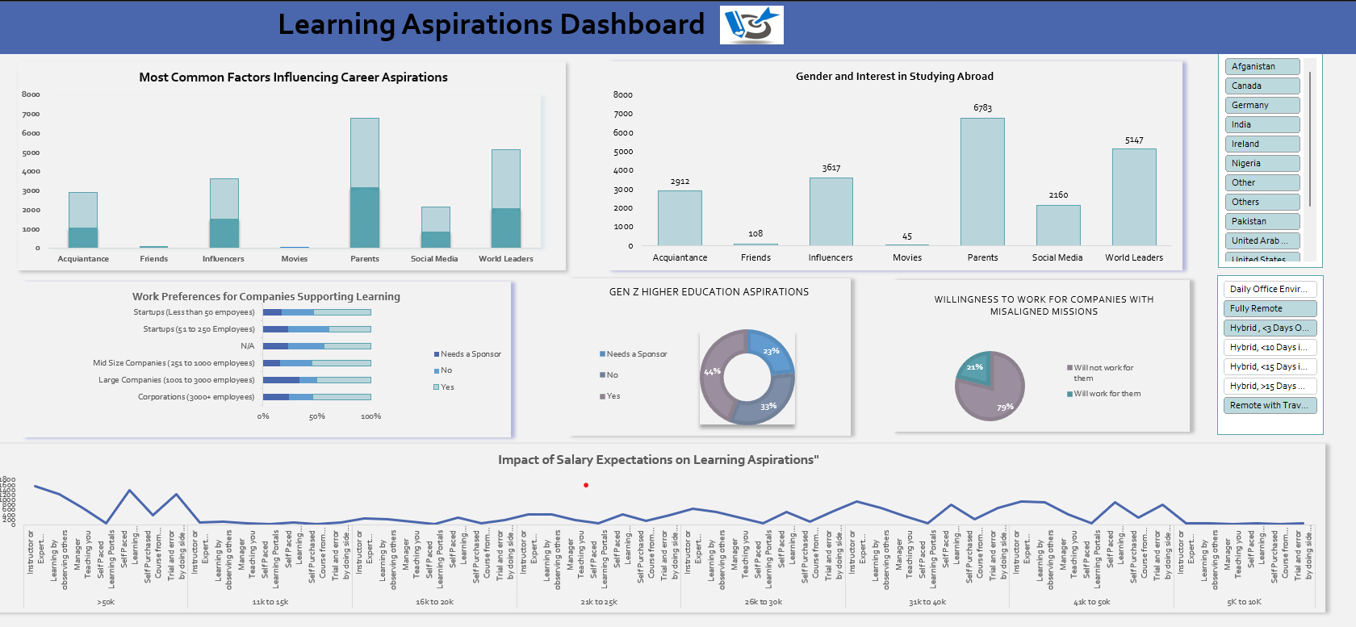
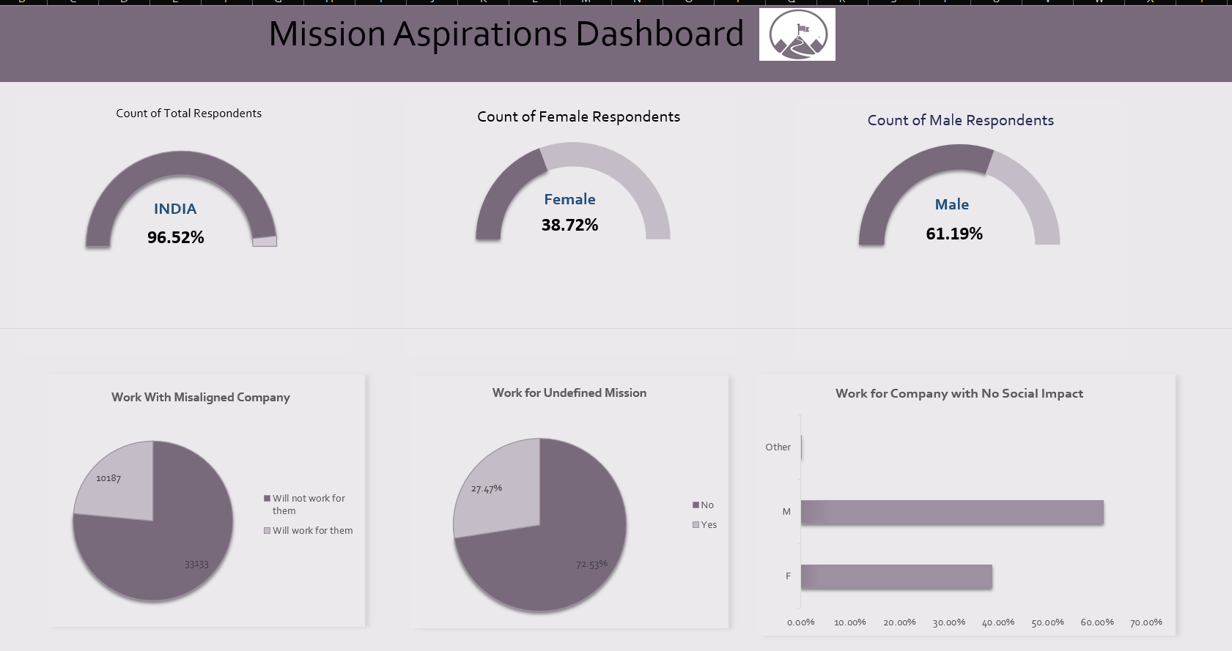
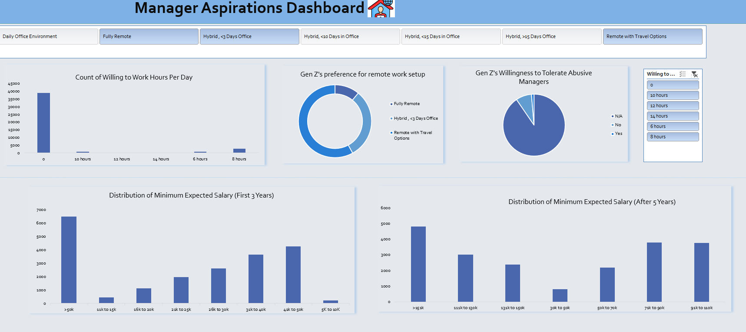
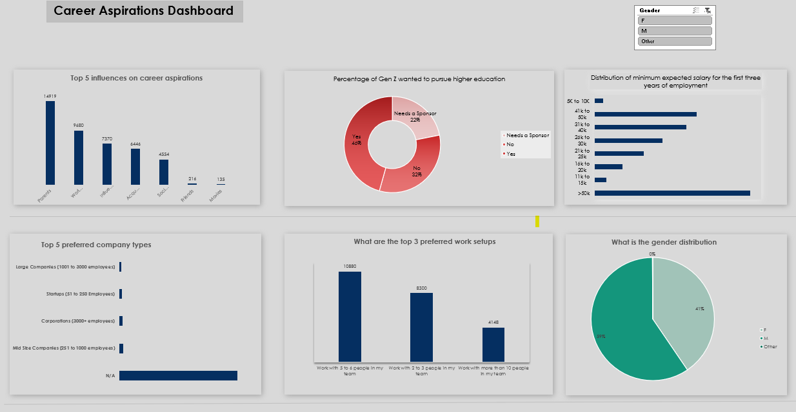

Slide 5

Key 'Wow' Insights
Over 80% of Gen-Z professionals prioritize continuous learning over promotions.
Employees are 50% more likely to stay in organizations with clear social missions.
Leadership interest peaks at mid-career stages rather than entry-level.
Hybrid work models saw a 70% preference over traditional office setups.
Technical and interpersonal skills are equally valued, with a 40%-40% split in importance.

Slide 6

PROBLEM
PROBLEM
PROBLEM
Poor Managers or Leadership
Poor or Low Salaries
Stagnant Growth
RECOMMENDATIONS
RECOMMENDATIONS
RECOMMENDATIONS
Create personalized career development plans
Provide constructive feedback
Establish clear criteria for promotions
Encourage cross-functional projects
Recognize and celebrate employees’ achievements
Invest in leadership development programs
Implement a feedback system
Schedule regular meetings with the managers and teams to ensure open communication
Conduct regular market research
Implement performance-based pay
Communicate openly about the company's financial situation
Enhance non-monetary benefits such as health insurance, flexible work hours or professional development opportunities

Slide 7

Takeaways
Effective stakeholder communication ensures alignment with project objectives.
Data visualization significantly enhances the understanding of complex datasets.
Early planning and clear timelines mitigate risks of delays.
Continuous data validation is crucial for maintaining accuracy.
Collaboration among teams improves the overall quality of deliverables.

